Slide 1
Treasurer’s Workshop
Treasurer’s Workshop
Building Church Leader’s 2023

Slide 2
Treasurer’s Monthly Reports (TMR)
Master file with formulas and instructions available on website: Forms and Documents | The Episcopal Diocese of San Joaquin (diosanjoaquin.org)
Due by 15th of the following month
Electronic submission is awesome
ACH or digital remittance encouraged
You can email the TMR and send payment with a remittance form available on the website.
Send to Nichole at dioadmin@diosanjoaquin.org

Slide 3
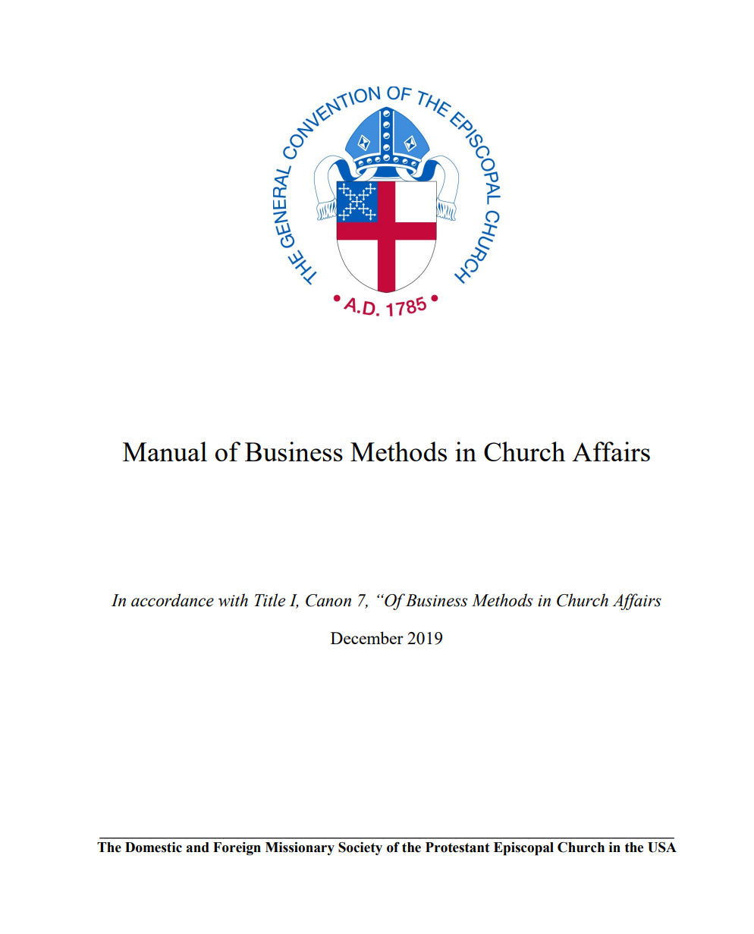
Episcopal Business Manual
Forms and Documents | The Episcopal Diocese of San Joaquin (diosanjoaquin.org)
Under Treasurer Forms and Resources
This is a valuable resource!

Slide 4
Congregational Management Review
Why do we do reviews?
It is required by our Canons & Constitution
It provides accountability for everyone
It helps you improve financial procedures,
business management and operations
Many grants available through The Episcopal
Church require not only an application,
but also, the most up to date audited financials
Formerly known as “the audit”
Forms and Documents | The Episcopal Diocese of San Joaquin (diosanjoaquin.org)

Slide 5
Congregational Management Review
Key Dates:
March 31
The names of your Congregational Management Review team (for self and peer audits) or outside
auditor is due to the diocese.
June 30
Final reports are due - (unless you have an approved extension from the Canon
The revised manual includes the checklists and sample reports. It is available on the Diocese website/forms
Revised manual is available online: Forms and Documents | The Episcopal Diocese of San Joaquin (diosanjoaquin.org)
Under Treasurer Forms and Resources

Slide 6
Congregational Management Review
New 3-year review cycle
Outside audit in 2022? 2023 do self-audit
2024 do peer audit
Self-audit in 2022? 2023 do peer audit
2024 do outside audit
A peer audit is defined as: “a neighboring congregation reviews your materials for you and submits the report for your congregation.”
An outside audit is defined as: “a diocesan approved auditor reviews your materials and submits the report for your congregation.” Congregation cost is $500 paid to auditor
yes
no
yes
New cycle =
self
peer
outside

Slide 7
Congregational Management Review
Closing thoughts …..
The final review report should remain with your Vestry/BC/Chapter
A copy of the review report is due to the diocesan office by June 30
Please do not wait till June 1 to start your review. Peer reviews and outside reviewers need to be arranged by March 31.
Call us if you have questions. Extensions are possible, but all reviews MUST be completed by October 1.
Enjoy collaborating with and getting to know your neighboring congregations.
Thank you all for being here today!
Financial matters contact info:
Canon Anna Carmichael canonanna@diosanjoaquin.org
for review extensions, outside reviewer info or peer review suggestions.
Nichole Pardo dioadmin@diosanjoaquin.org
for TMR questions, billing, payment arrangements, payroll and your first stop for most everything financial and administrative.
Cathy Peck
cpeck@diosanjoaquin.org
for treasurer matters, accounting or reporting questions and general assistance

